Slide 1
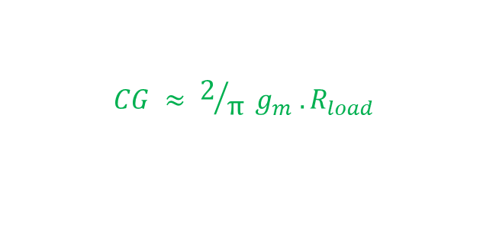
How Conversion Gain is effected by circuit parameters
$$CG ≈ 2/π g_{m} . R_{load}$$

Slide 2
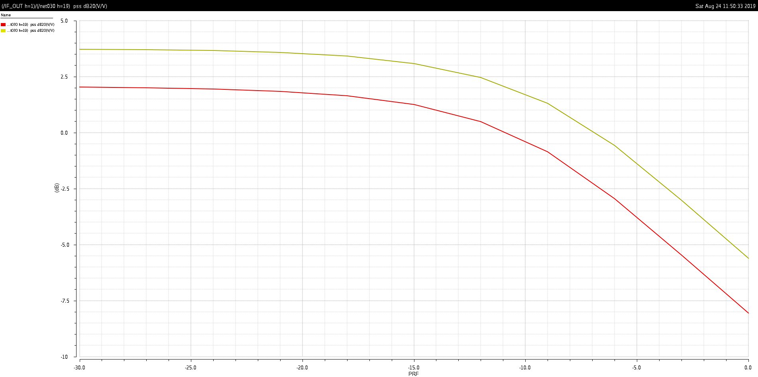
1) Increasing the tail current
CG increase

Slide 3
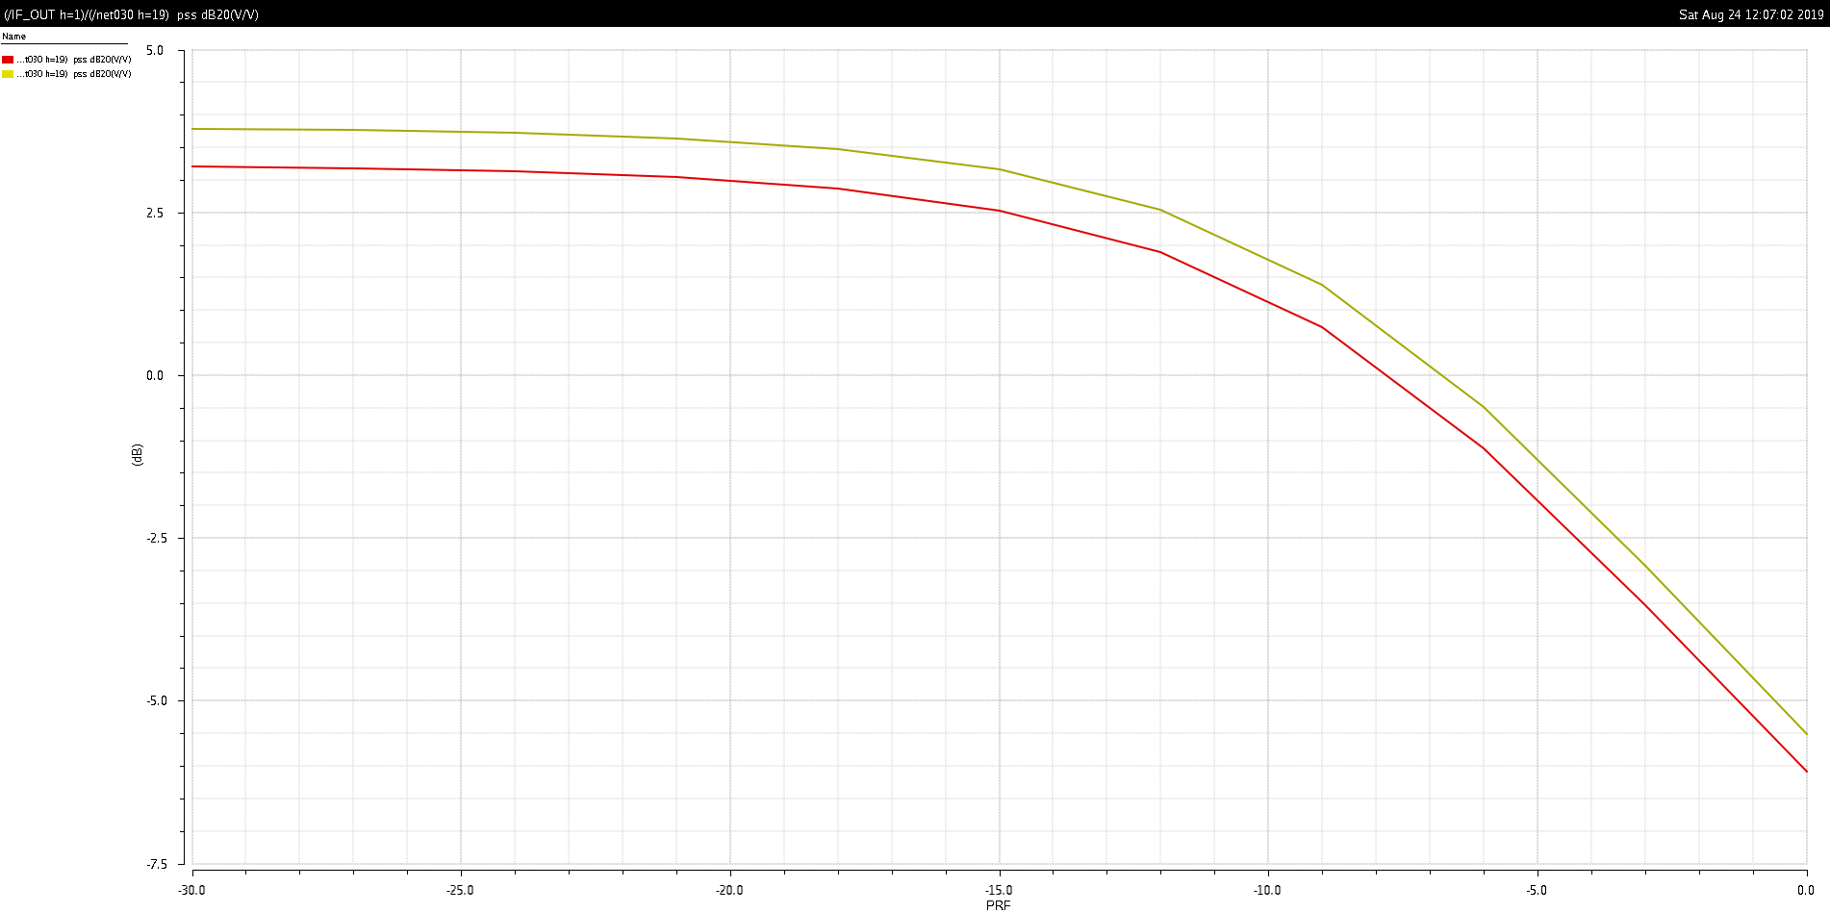
2) Decreasing L of LO switches
The LO switches should ideally act as perfect switches, so decreasing L or increasing W should help the CG.
CG increase

Slide 4
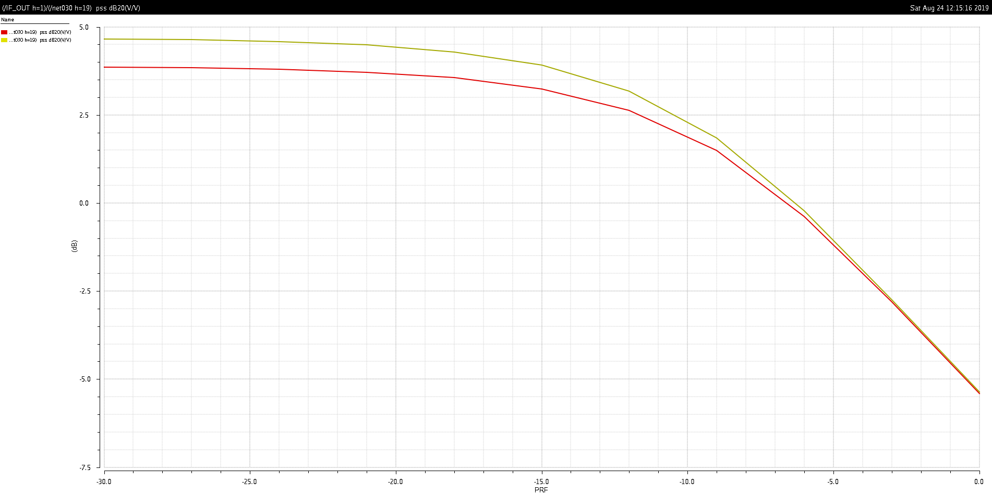
3) Increasing W of RF (input) devices
CG depends on the gm of the RF (input) transistors.
CG increase

Slide 5
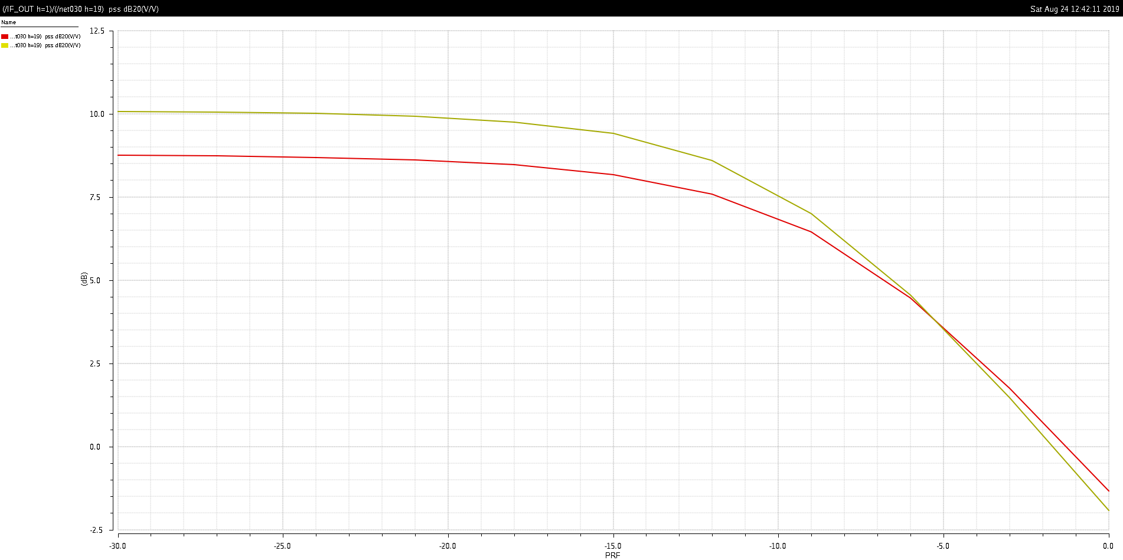
4) Increasing R load
CG depends on the R load
CG increase

